Slide 1


2017年第三届PIA程序设计试水赛
South China Agricultural University
College of Mathematics and Informatics
January 10, 2017
2017PIA程序设计试水赛 pia_scau@foxmail.com

Slide 2





Day1(A)
Catch the DingDing cat
Please try to write a program(AI) for this game called “Catch
the DingDing cat” in MATLAB :
function direction=Your-name(player1,player2,signvalue,k,code)
Fangxue no go!
DingDing cat
Please watch the video below for more details!
2017PIA程序设计试水赛 pia_scau@foxmail.com

Slide 3
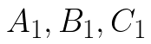
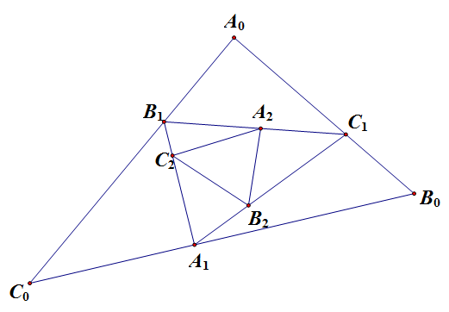
Day1(B)
Random sub-triangle of triangle
Now on each side of the triangle we randomly(independently and
uniformly) choose points .The new triangle is now formed by
these three points. Repeat this procedure indefinitely. What is the limit
of the shape?
Attentions and hints:
(Undoubtedly, the limit of the triangle is a point and what we should consider is the
shape of it. So, we may have a normalization for each new triangle.)
2017PIA程序设计试水赛 pia_scau@foxmail.com

Slide 4


Day1(C)
What's the difference?
Have a try to write a program to look for the differences between
these images .
2017PIA程序设计试水赛 pia_scau@foxmail.com

Slide 5
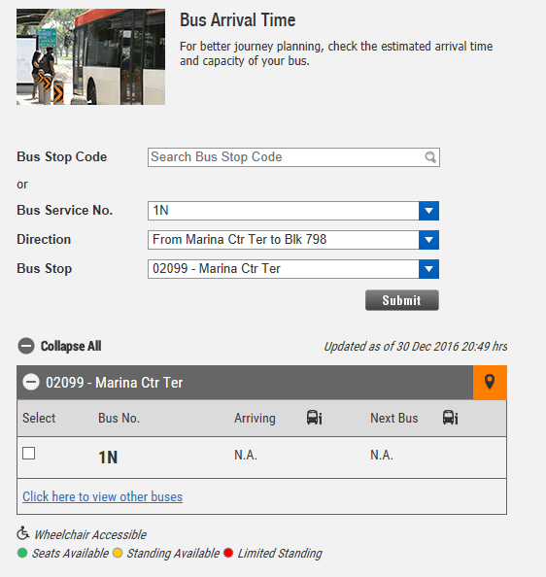
Day2(A)
Traffic Data System Construction
When you choose a Bus Service No、 Direction and Bus Stop, the website will return the estimated arriving time when that car drove in that direction will arrive that bus stop.
Please fetch all the combination of the Bus Service No、Direction and Bus Stop.
Please watch the video below for more details!
2017PIA程序设计试水赛 pia_scau@foxmail.com

Slide 6
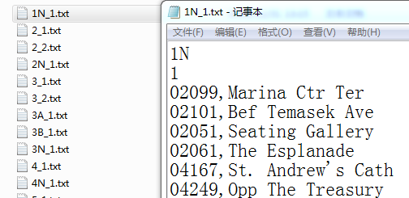
Day2(A)
Traffic Data System Construction
Bus Service No.=1N
Direction=1
File name:
Bus Service No_Direction.txt
Bus Stop:{Bus Stop ID, Bus Stop Description}
2017PIA程序设计试水赛 pia_scau@foxmail.com

Slide 7
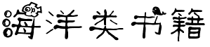

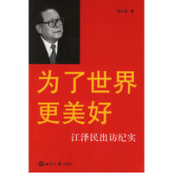






Day2(B)
Verification code of 12306
Have a try to write a program to finish the problem as follow.
请找出下图中所有的
刷新
登陆
快速注册
2017PIA程序设计试水赛 pia_scau@foxmail.com

Slide 8

Day2(C)
"sequencing " problem
All the time, NBA calculates the TOPG(Turnover Per Game) of
every players. If there are 77 NBA players, we need to find out 7 players
whose TOPG is smallest. In short, algorithm requires the following:
1.The following sorting algorithms cannot be used(Bubble sort, selection
sort, insertion sort, quick sort, Hill sort, merge sort),and we encourage you
to put forward your own sorting algorithm;
2.Don't directly call the Min function, the Max function and other similar
functions;
3.Minimize the time complexity and space complexity.
2017PIA程序设计试水赛 pia_scau@foxmail.com

Slide 10
2017年第三届PIA程序设计试水赛
South China Agricultural University
College of Mathematics and Informatics
January 10, 2017
2017PIA程序设计试水赛 pia_scau@foxmail.com

Slide 11
Day1(A)
Catch the DingDing cat
Please try to write a program(AI) for this game called “Catch
the DingDing cat” in MATLAB :
function direction=Your-name(player1,player2,signvalue,k,code)
Fangxue no go!
DingDing cat
Please watch the video below for more details!
2017PIA程序设计试水赛 pia_scau@foxmail.com

Slide 12
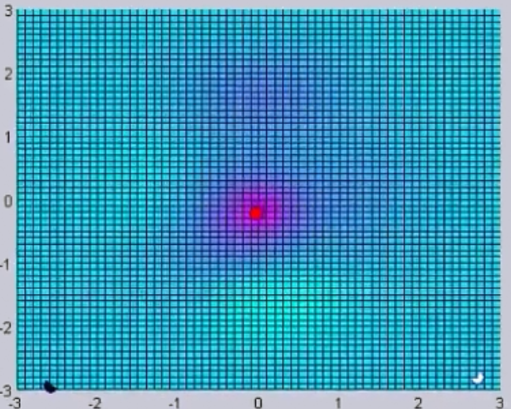
Day1(A)
Catch the DingDing cat
Cat
[0,0]
Player1
[-3,-3]
Player2
[3,-3]
2017PIA程序设计试水赛 pia_scau@foxmail.com

Slide 13
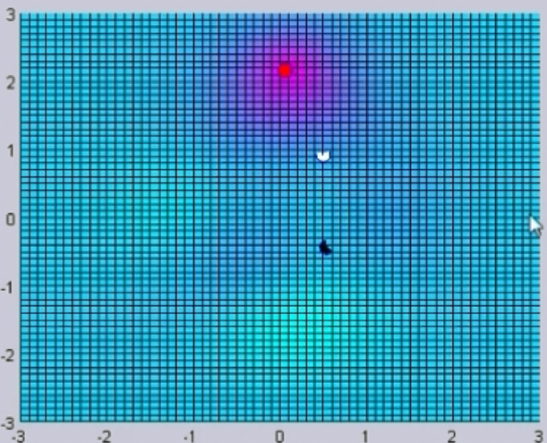
Day1(A)
Catch the DingDing cat
2017PIA程序设计试水赛 pia_scau@foxmail.com

Slide 14
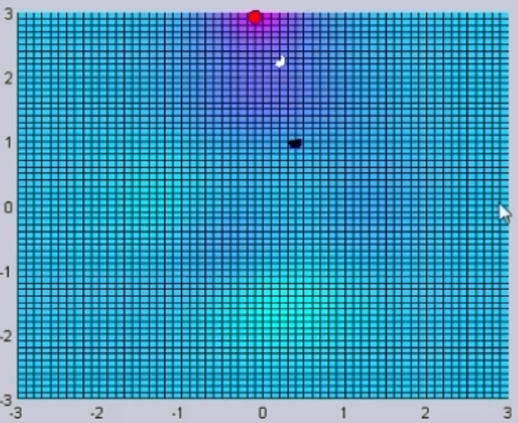
Day1(A)
Catch the DingDing cat
2017PIA程序设计试水赛 pia_scau@foxmail.com

Slide 15
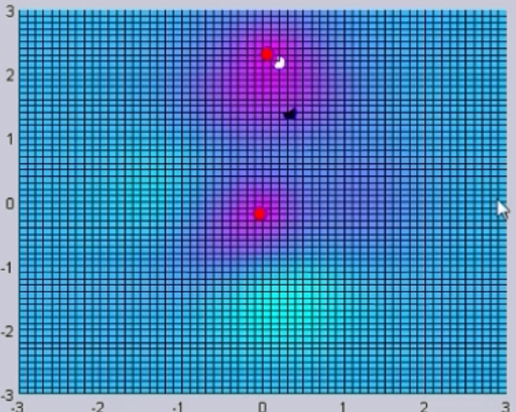
Day1(A)
Catch the DingDing cat
2017PIA程序设计试水赛 pia_scau@foxmail.com

Slide 16
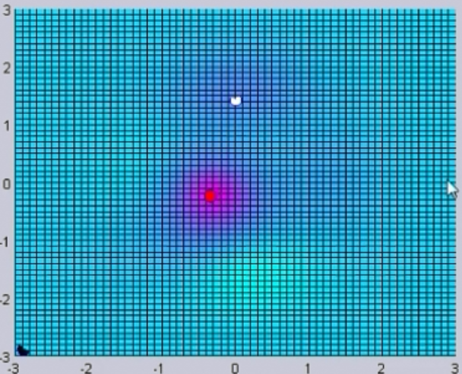
Day1(A)
Catch the DingDing cat
2017PIA程序设计试水赛 pia_scau@foxmail.com

Slide 17
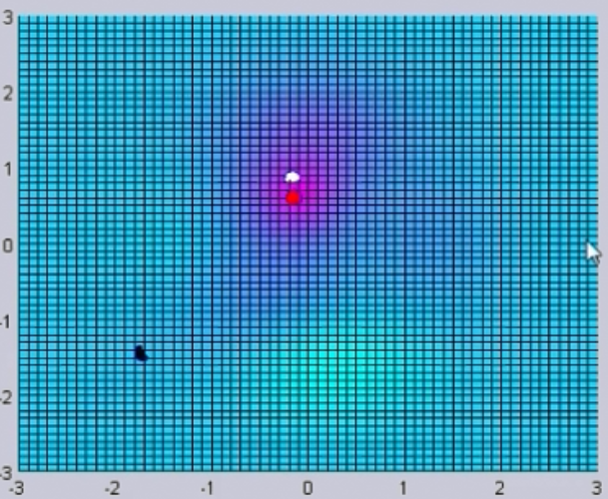
Day1(A)
Catch the DingDing cat
2017PIA程序设计试水赛 pia_scau@foxmail.com

Slide 18
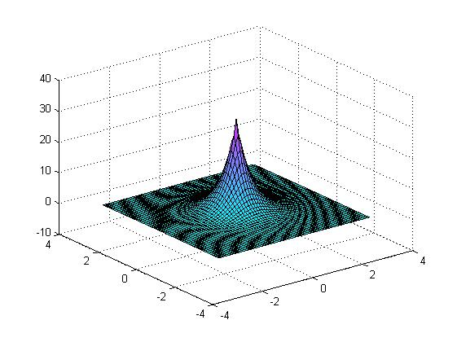
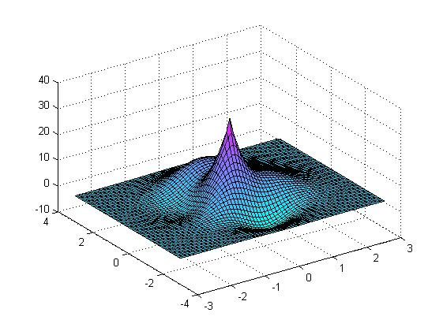
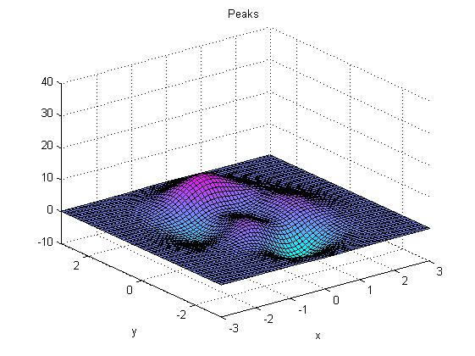
Day1(A)
Catch the DingDing cat
DingDing cat
Initial terrain
Final terrain
2017PIA程序设计试水赛 pia_scau@foxmail.com

Slide 19
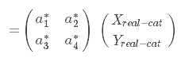
Day1(A)
Catch the DingDing cat
Please try to write a a program(AI) for this game called “Catch
the DingDing cat” in MATLAB :
function direction=Your-name(player1,player2,signvalue,k,code)
Your coordinate
Another player’s coordinate
Round k
signvalue
You will be asked to provide your next direction
(a vector, like [Xa, Ya])
2017PIA程序设计试水赛 pia_scau@foxmail.com

Slide 20

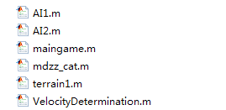
Day1(A)
Catch the DingDing cat
[X,Y]=meshgrid(-3:0.1:3);
function f=terrain1(X, Y, signvalue, code)
(You can use it)
1
2
3
4
5
6
2017PIA程序设计试水赛 pia_scau@foxmail.com

Slide 21
Day1(A)
Catch the DingDing cat
[X,Y]=meshgrid(-3:0.1:3);
function f=terrain1(X, Y, signvalue, code)
(You can use it)
function direction=Your-name(player1,player2,signvalue,k,code)
2017PIA程序设计试水赛 pia_scau@foxmail.com

Slide 22

Day1(A)
The number of circles
How many red circles and blue circles in the picture as follow?
Have a try to write a program to finish this problem.
2017PIA程序设计试水赛 pia_scau@foxmail.com

Slide 23
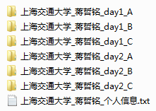


提交方式
注意事项：
1.个人信息格式:(颁奖用)
上海交通大学_电气工程系_电机专业_2014级_蒋哲铭；
2.可以多次提交，以最新提交为准，每次提交都需要把你已经完成的所有题目最新解答提交；
3.答卷以PDF格式提交，须用英国话详细作答；
4.请注意每一题中的特殊的要求；
pia_scau@foxmail.com
邮件主题：上海交通大学_蒋哲铭（第k次提交）
2017PIA程序设计试水赛 pia_scau@foxmail.com

